Slide 1
Deriving Rules From Data
Deriving Rules from Data
Machine Learning Algorithms
MIS 637
Artificial Neural Network Algorithm
An Overview
M. Daneshmand
MD-MIS 637 Fall 2020

Slide 2
Biological Principles Underlying the ANN
Human Brain
A network of 10^11 nerve cells called neurons connected to each other via 10^15 synapses
initially theorized in 1943 by McColloch and Pitts of U of Chicago,
simulates the brain’s cognitive learning process,
“learns” patterns directly from the data,
searches for complex relationships,
automatically builds models,
predicts - compares - adjusts,
corrects the model’s mistakes over and over again,
input: Data,
output: Prediction
tool: the Model “learned” from the Data.
MD-MIS 637 Fall 2020

Slide 3
Neural Networks
Simulating the Brain to Solve Problems
Artificial Neural Networks (ANN)
Overview
Computer emulation of biological neural systems for building models:
  initially theorized in 1943 by McColloch and Pitts of University of Chicago,
  simulates the brain’s cognitive learning process,
  “learns” patterns directly from the data,
  searches for complex relationships,
  automatically builds models,
  predicts - compares - adjusts,
  corrects the model’s mistakes over and over again,
  input: Data,
  output: Prediction
  tool: the Model “learned” from the Data.
MD-MIS 637 Fall 2020

Slide 4
Neural Networks
Biological Principles Underlying the Neural Network Technology
The idea of neurons as the structural constituent of the brain was first introduced by Ramon y Cajal (French) 1911
Human Brain:
  a network of individual but interconnected nerve cells called neurons (10^11 neurons)
  neurons are connected to each other via huge number of so-called synapses (10^15 synapses
  or connections),
  a given neuron is connected to 10 thousand other neurons by these synapses,
  neurons can receive information from the outside world at various points in the network,
  these pieces of information are called stimuli,
  a neuron transfers information on to other neurons by firing chemicals called
  neurotransmitters,
  these transfers occur over synapses like bursts of electricity,
  the more important a particular stimulus is, the stronger the burst will be at the synapses,
  the information received by a nerve cell at one of the synapses either excite or inhibit the cell,
  if the receiving cell is excited, it will pass the information to other neurons,
  if the receiving cell is inhibited, it will damp the impact of the information,
  each nerve cell processes the raw input but passes it on only if it is important,
  the information travels through the network by generating new internal signals,
  the stimuli are processed by brain and nervous system and ultimately a response is
  produced.
MD-MIS 637 Fall 2020

Slide 5

Neural Networks
Artificial Neural Networks
  a system of neurodes (nodes) and weighted connections (synapses) inside the memory of a
  computer,
  nodes are data storage locations (like variables in a program, cells in a spreadsheet),
  nodes are arranged in layers with weighted connections running between layers,
  balls represent nodes and lines represent connection weights,
  input layer nodes receive the data,
  output layer nodes relay the response of the neural network out of the net,
output layer
guesses
hidden layer
internal processing
input layer
data
A Simple Neural Network
MD-MIS 637 Fall 2020

Slide 6
Neural Networks
ANN (Continued)
  hidden layer nodes (hidden from the outside world) conduct the internal
  processing,
  data are fed into the net through the input nodes,
  data are processed internally by hidden nodes, based on the inter-node
  connection weights,
  result are passed on to the outside world by output nodes,
  “learning” takes place through adjusting connection weights,
  a “learned” neural network has adjusted its weights properly
ANN operates in the same way as the biological model on which it is based.
MD-MIS 637 Fall 2020

Slide 7
Neural Networks
ANN (Continued)
We have training data, input/independent/predictor variables, output/dependent/target/prediction variables – Labeled Data
We have NN architecture: input layer & number of nodes of input layer, number of hidden layers & number of nodes in each of the hidden layers, we have output layer & number of nodes of the output layer, we have specified the connection structure,
We have determined connections weights,
THEN WE Have a “learned/fitted” neural network/model
Application of a “Learned” Neural Network
Each neuron of a “learned” neural network performs two essential functions: Integration and transfer (activation)
MD-MIS 637 Fall 2020

Slide 8
Neural Networks
Application of a Learned Neural Network
Integration Function:
  each neuron receives a set of raw data (input),
  the neuron multiplies each input by the connecting weight leading into it,
  connection weight determines the importance of a given input in contribution to the output
  of the neuron,
  more important inputs will have bigger weights and less important ones will have smaller
  weights,
  the integration function of the neurode calculates a weighted sum of all inputs.
o
u
t
p
u
t
-
sum
+
Sum up
weighted inputs
Inputs from lower layer
MD-MIS 637 Fall 2020

Slide 9
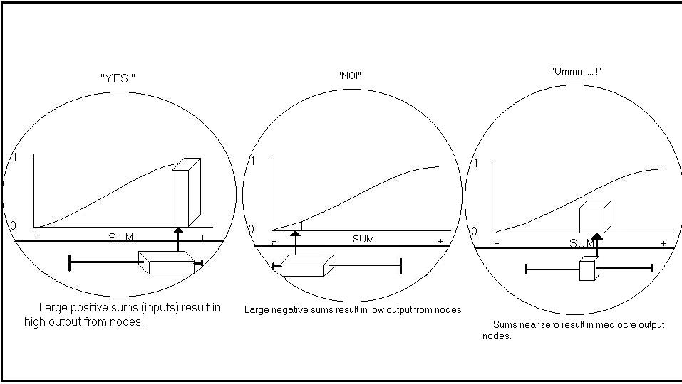
Neural Networks
Application of a Learned Neural Network (Continued)
Transfer Function:
  the weighted sum is converted into an output value using a mathematical function called
  transfer function,
  transfer function normalizes the output into the range of [0,1],
  it serves as a kind of “dimmer” switch for turning the neuron “on” and “off ”,
  the transfer function’s value will be high (excited) when the sum of the inputs is large &
  positive; and low (inhibited) when the sum is large negative,
  the transfer function determines the degree at which a given sum will cause a neurode to fire.
MD-MIS 637 Fall 2020

Slide 10
Neural Networks
Training a Neural Network
Steps: 0: decide on NN architecture: input nodes, hidden layers/nodes, output nodes
  step 1: start with a set of “training data” where both the inputs and the output(s) are known,
  “correct” output, the experience to be used to train the net - Labeled Data
  step 2: set all the initial connection weights to arbitrary small random numbers, sum about
  0, output about 0.5, initial neutral position,
  step 3: present the net with one case of input data, let the net predict the output
  (Yk), compare the predicted output with the “correct” output (Dk),
  step 4: prediction matches the correct output: Yk –Dk=0, do nothing,
  step 5: prediction deviates from the correct output: calculate the error, adjust weights to
  reduce the error, : predict - compare - adjust,
  step 6: repeat the predict - compare - adjust process for each of the cases (often many) of the
  “training data" until the network has been “trained”, that is, the prediction error
  has been “minimized”.
  Step 7: test the trained net with a set of “testing data” that it had never seen before. If the
  performance is satisfactory, then we have a “learned” net model.
MD-MIS 637 Fall 2020

Slide 11
Neural Networks
Learning Methods
Definition: The manner in which the net actually finds and adjust weights is called Learning Method
Supervised Learning:
  the net is presented with input data, along with the correct (desired) output data (result(s)),
  the set of input and correct output guides the net to a good solution,
  the net is being ‘supervised” by a “mentor” to find where it might be making mistakes,
  there are numerous supervised learning methods,
  the most common supervised method is back propagation (backprop),
  in back propagation (backprop) the error between desired and predicted output propagates
  back through the network in order to adjust weights.
Unsupervised Learning:
  the net is presented with the input data but not the desired (correct) output results,
  the net is allowed to be trained unsupervised,
  it seeks to find similarities among the different data records,
  the net discovers possible patterns, clusters, and relationships.
MD-MIS 637 Fall 2020

Slide 12
Neural Networks
A Case Study: Real State Appraisal
Business Need: An accurate appraisal of the market value of a real state property is crucial for a large mortgage company that needs to assess the risk of an individual loan.
Goal: A model to appraise market value of a home based on characteristics of the property.
Input (Independent) Variables: Common variables (features) describing a house
Feature Description Values
Num_Apartments Number of dwelling units 1-3
Year_Built Year Built 1850-1986
Plumbing_Fixtures Number of plumbing fixtures 5-17
Heating_Type Heating system type Coded as A or B
Basement_Garage Basement garage (Number of cars) 0-2
Attached_Garage Attached frame Garage Area (Square feet) 0-228
Living_Area Total living area (Square Feet) 714-4185
Deck_Area Deck/open porch area(Square feet) 0-738
Porch_area Enclosed porch area(Square feet) 0-452
Recroom_area Recreation room area(Square feet) 0-672
Basement_area Finished basement area(Square feet) 0-810
MD-MIS 637 Fall 2020

Slide 13
Neural Networks
A Case Study: Real State Appraisal (contd.)
Output (Dependent) Variable (s):
  sales price (correct output for training, market value appraisal for prediction),
Data Source: Federal Home Loan Mortgage Corporation
Neural Net Topology (Architecture):
  input layer consisting of 11 nodes (one node for each input variable),
  one hidden layer consisting of two nodes fully-connected to all input nodes,
  output layer consisting of one node (one output is required: market value of home) fully-
  connected to all hidden nodes.
MD-MIS 637 Fall 2020

Slide 14
Neural Networks
A Case Study: Real State Appraisal
  Training Data Set: variables, ranges, an example
Feature Range of Values Original Value Massaged value
Sales_Price $103,000-$250,000 $ 171,000 0.4626
Months_Ago 0-23 4 0.1739
Num_Apartments 1-3 1 0.0000
Year_Built 1850-1986 1923 0.5328
Plumbing_Fixtures 5-17 9 0.3333
Heating_Type Coded as A or B B 1.0000
Basement_Garage 0-2 0 0.0000
Attached_Garage 0-228 120 0.5263
Living_Area 714-4185 1,614 0.2593
Deck_Area 0-738 0 0.0000
Porch_Area 0-485 210 0.4646
Recroom_Area 0-672 0 0.0000
Basement_area 0-810 175 0.2160
MD-MIS 637 Fall 2020

Slide 15
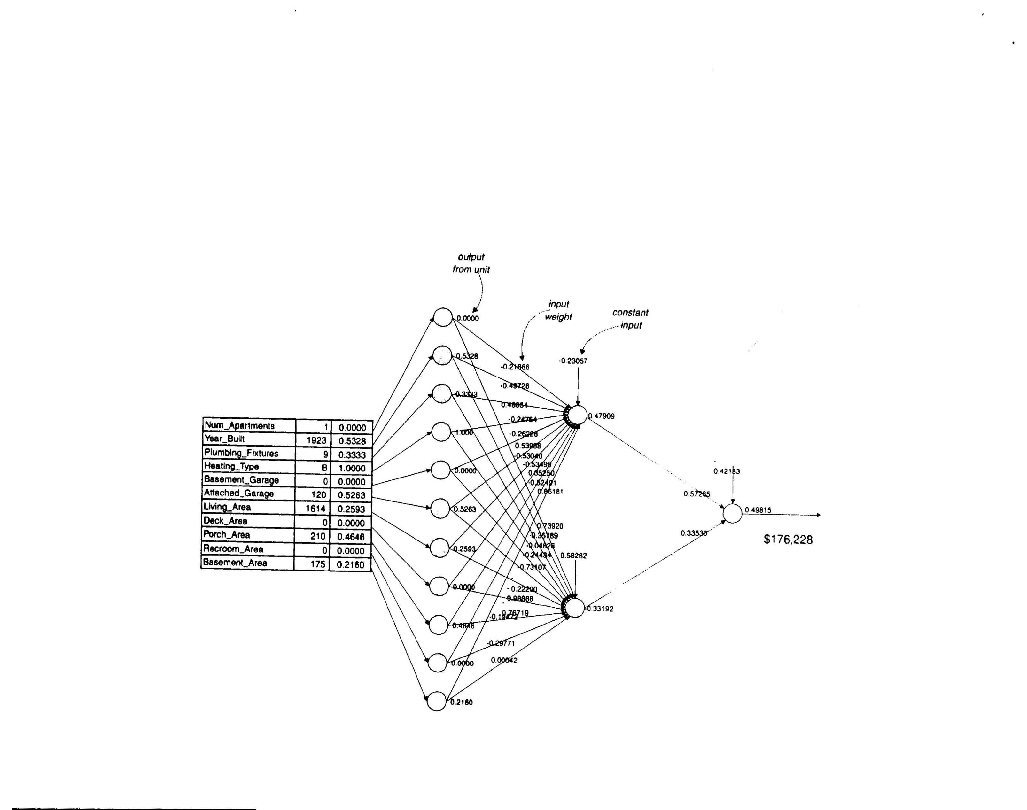
Neural Networks
A Case Study: Real State Appraisal
  Real Estate Appraisal Neural Net
MD-MIS 637 Fall 2020

Slide 16
Neural Networks
Summary and ID Dimensions
Dimension Neural Network But…..
Accuracy High Needs comprehensive training data
Explainability Low Some mathematical analytic methods exist
For doing sensitivity analysis.
Response Speed High --------------------------------------------
Scalability Moderate Depends on complexity of problem.
Availability of Data
Compactness High --------------------------------------------
Flexibility High Needs representive training data
Embeddability High --------------------------------------------
Ease of Use Moderate --------------------------------------------
Tolerance for Complexity High -------------------------------------------
Tolerance for Noise in data Moderate-High Preprocessing is useful in dealing with noise
Tolerance for Sparse Data Low --------------------------------------------
Independence from experts High --------------------------------------------
Development speed Moderate Depends on understanding of process, on computer Speed and learning paradigm.
Computing resources Low- Moderate Scale with respect to amount of data and
Size of network. Trained ANN needs little
computing resource to execute.
MD-MIS 637 Fall 2020

Slide 17

Human Eye:
Smart Data Selection/Reduction
Smart data selection
Intelligent data Processing (selective attention and information-extraction)
(image source: KRISTEN NICOLE, siliconangle.com)
MD-MIS 637 Fall 2020

Slide 18
Human Eye
Human eye has over 130 million receptors (sensors),
Usually around 30% of our cognitive brain power is dedicated to visual processing and visual senses,
If all these 130million receptors send information at the same time back, the human brain will not be able to process the information,
Brain/eye use a technique called selective attention and by deciding the focus of visual sense different arrays (are organized in layers) fire information back to the brain (for example, when we focus on edges, other details get blurry/blend,
When we focus on someone's face the rest of background is not see as detailed as before, etc.),
For IoT and streaming data we also need some mechanisms of selective attention to decide what to collect, and what to store (and for how long)
MD-MIS 637 Fall 2020

Slide 19




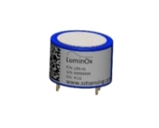
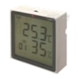



Selective Sensing in IoT
Data/Information explosion & Limited Sensing
Selective Sensing (selectively processing raw sensed data based on the real-time situation instead of attempting to fully process the massive data in parallel) was proposed to tackle these issues in IoT and attracted wide attention with its unique advantages.
Physical Space
Interface
Cyberspace
Sensors
Resource Waste
001101011011
Contradiction
Explosive big data
Limited sensing resources
A large number of useless data
Limited computing and storage resources

Slide 20



Biological Attention Mechanism
When a cheetah is hunting a deer, it will pay all efforts on the information related to the deer while ignoring other irrelevant information in order to catch the deer fleetly.
Attention Mechanism
Four main sub-components
When someone is looking for a person, he/she will ignore other irrelevant information and focus only on the person, discarding many other information about the surrounding environment
The behavior and cognitive process in which we selectively concentrate on a limited set of information from the enormous amount of perceivable information
Focused Attention
Sustained Attention
When we are enjoying a show, we will focus on the stage and the performance while ignore other irrelevant information, including the surrounding environment
Selective Attention
Divided & Alternating Attention

Slide 21
Artificial Intelligence (AI)
MD-MIS 637 Fall 2020

Slide 22
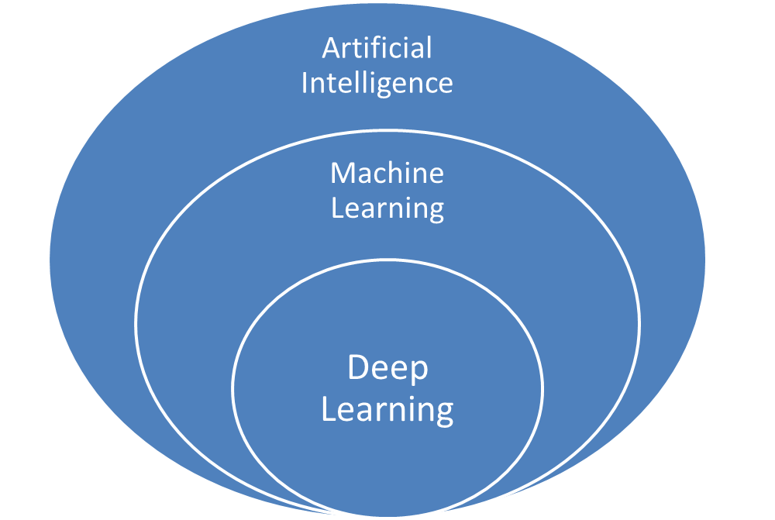
AI Terminologies
IoT
Data Science
MD-MIS 637 Fall 2020

